Slide 1
Modern Data Infrastructure and DataOps
Sunil Bhutada

Slide 2
Agenda
Introduction
Data Ingestion Infrastructure
Data Transformation Infrastructure
Workflow Orchestration Platforms
Data Storage Infrastructure
Data Serving Infrastructure
Automation in Data Infrastructure Management
DevOps & DataOps Foundation
Cloud Foundation
Security Foundation
Continuous Training (CT) and Continuous Deployment (CD) pipelines
DataOps and Observability
Case Study

Slide 3
Introduction

Slide 4
Data Pipeline Architecture – Re-Introduction
Reverse ETL
Generation/Source
Ingestion
Data Analytics
Storage
Transformation
Serving
Data Science & Machine Learning

Slide 5

Key Drivers from Last 2 Decades
Emergence of the major public cloud providers
(AWS, GCP, Azure)
Modernization of Datawarehouse
Ease of building and deploying
Drop-in storage costs
Contributed To
Data Lakes
Emergence of highly scalable, columnar databases
(Redshift, Snowflake, BigQuery)

Slide 6
Data Ingestion Infrastructure

Slide 7
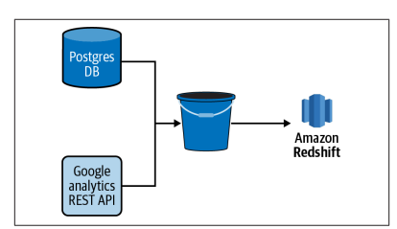
Generation / Source Systems
For instance consider an ecommerce company
Stores data from their shopping cart in a PostgreSQL database behind their web app
Uses a third-party web analytics tool such as Google Analytics to track usage on their website
Combination of the two data sources is required to get a full understanding of customer behavior leading up to a purchase
The majority of organizations have dozens, if not hundreds, of data sources that feed their analytics endeavors
Typical for an analytics team to ingest data from source systems that are built and owned by the organization as
well as from third-party tools and vendors
A data pipeline that ends with an analysis of such behavior starts with the ingestion of data from both sources.
Regardless of who owns the source data, how you get it and in what form is the first thing a data engineer will examine when building a new data ingestion

Slide 8
Data Ingestion Infra – Key parameters
Interface to the data
Structure of the data
how to get data
A database behind an application, such as a Postgres or MySQL database
A layer of abstraction on top of a system such as a REST API
A stream processing platform such as Apache Kafka
A shared network file system or cloud storage bucket containing logs, comma-separated value (CSV) files, and other flat files
A data warehouse or data lake
Data in HDFS or HBase database
JSON from a REST API
Well-structured data from a MySQL database
SON within columns of a MySQL database table
Semi-structured log data
CSV, fixed-width format (FWF), and other flat file formats
JSON in flat files
Stream output from Kafka

Slide 9
Tools
Background
“Data teams must contend with a diverse range of data sources from which they must ingest data.”
Commercial Tools
A number of commercial and open source tools are available in a modern data infrastructure.
Singer
Stitch
Fivetran
Data ingestion is traditionally both the extract and load steps of an ETL or ELT process
Some tools focus on just these steps, while others provide the user with some transform capabilities as well

Slide 10
Data Transformation Infrastructure

Slide 11
Transformation & Modelling
Pipelines are also made up of tasks that transform and model data for new purposes
Such as machine learning, analysis, and reporting
Terms often used interchangeably
Data Transformation
Transforming data is a broad term that is signified by the T in an ETL or ELT process
A transformation can be something
As simple as converting a timestamp stored in a table from one time zone to another
A more complex operation that creates a new metric from multiple source columns that are aggregated and filtered through some business logic
Data Modeling
Data modeling is a more specific type of data transformation
A Data Model structures and defines data in a format that is understood and optimized for data analysis
A Data Model is usually represented as one or more tables in a data warehouse

Slide 12
Tools
Data Transformation
Some data ingestion tools provide some level of data transformation capabilities, but these are often quite
Simple
For the sake of protecting personally identifiable information (PII) it may be desirable to turn an email address into a hashed value
For more complex data transformations and data modeling, find it desirable to seek out tools and frameworks specifically designed for the task, such as dbt
Additionally data transformation is often context-specific and can be written in a language familiar to data
Engineers and data analysts, such as SQL or Python.
Data modeling Tools
Typically defined and written in SQL or via point-and-click user interfaces
SQL is a highly accessible language that is common to both data engineers and analysts
Empowers the analyst to work directly with the data and optimize the design of models for their needs
Used in nearly every organization, thus providing a familiar entry point for new hires to a team
In most cases, choosing a transformation framework that supports building data models in SQL rather than via a point-and click user interface is desirable!

Slide 13
Workflow Orchestration Platforms

Slide 14
Problem Statement
Sounds Simple?
Generation/Source
Ingestion
Transformation
External – so not to worry much
Python Code
SQL procedures
How is this complexity?
Source-2
Ingestion-2
Transformation-2
What if this has to run multiple times?
Source-n
Ingestion-n
Transformation-n
How long you can mange this with Python & SQL?

Slide 15
Solution
As the complexity and number of data pipelines in an organization grows
It’s important to introduce a workflow orchestration platform to data infrastructure
Manages the scheduling and flow of tasks in a pipeline
Eg:
Apache Airflow, Luigi, and AWS Glue, are designed for more general use cases and are thus used for a wide variety of data pipelines
Kubeflow Pipelines, are designed for more specific use cases and platforms (machine learning workflows built on Docker containers in the case of Kubeflow Pipelines

Slide 16
Data Storage Infrastructure

Slide 17
Introduction
Cornerstone in the data engineering life cycle
Underlies major stages – Ingestion, Transformation and Serving
Get stored many times when it moved though lifecycle
Reverse ETL
Generation/Source
Ingestion
Data Analytics
Storage
Transformation
Serving
Data Science & Machine Learning

Slide 18
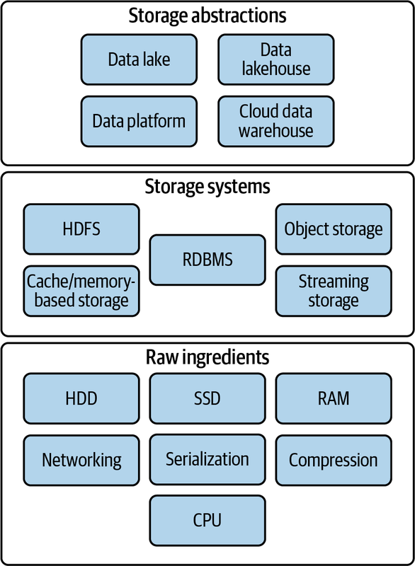
Storage Layering
Raw Ingredients of Data Storage: HDD/SDD/RAM, Networking and CPU, Serialization, Compression, Caching
Data Storage Systems: Single Machine Versus Distributed Storage, Eventual Versus Strong Consistency, File Storage, Block Storage, Object Storage, Cache and Memory-Based Storage Systems, The Hadoop Distributed File System, Streaming Storage, Indexes, Partitioning, and Clustering
Data Engineering Storage Abstractions

Slide 19
Data Storage Infrastructure -Raw Ingredients

Slide 20
HDD/SDD/RAM
Raw ingredients that compose storage systems, including hard drives, solid state drives, and system memory.
Hard Drives (HDDs — Hard Disk Drives): These are mechanical storage devices that use rotating disks coated with magnetic material to store data. They offer large storage capacities at relatively lower costs but are slower in terms of data access compared to SSDs.
Solid State (SSDs): SSDs are storage devices that use flash memory to store data. They have no moving parts, making theDrivesm faster, quieter, and more durable than HDDs. SSDs offer faster data access and are commonly used for faster performance in computers and servers.
System Memory (RAM — Random Access Memory): RAM is volatile memory used by computers to temporarily store data that the CPU needs to access quickly. It provides fast access to data and instructions, allowing the CPU to operate efficiently. However, unlike storage drives, RAM loses its data when the computer is powered off.

Slide 21
Networking and CPU
Networking and CPU are essential components in modern distributed storage systems.
Networking facilitates data distribution across multiple nodes, enhancing performance, durability, and availability.
CPUs handle request servicing, data aggregation, and distribution.

Slide 22
Serialization
Essential for database design and network efficiency, it packs data into a standard format for storage or transmission.
Purpose: Facilitates data exchange between systems using formats like XML, JSON, or CSV for compatibility across platforms.
Algorithm: Handles data types, structures, and exceptions, accommodating complex data structures like cyclic references.
Database Storage: Utilizes row-oriented (e.g., relational databases) and columnar (e.g., columnar databases) approaches, each optimized for specific tasks.
Most popular current formats (e.g., Apache Parquet), hybrid serialization (e.g., Apache Hudi), and in-memory serialization (e.g., Apache Arrow).

Slide 23
Compression & Caching
Compression
Critical for storage efficiency, reducing data size and improving scan speed and network performance.
Caching
Stores frequently or recently accessed data in a fast access layer, critical for data serving, processing, and transformation

Slide 24
Data Storage Infrastructure - Storage Systems

Slide 25
Introduction
Storage systems exist at a level of abstraction above raw ingredients.
For example, magnetic disks are a raw storage ingredient, while major cloud object storage Data Storage Systems | 197 platforms and HDFS are storage systems that utilize magnetic disks.
Before getting into the details, we need to understand major comparisons
Major Comparisons
Single Machine vs Distributed Storage
Eventual vs Strong Consistency

Slide 26
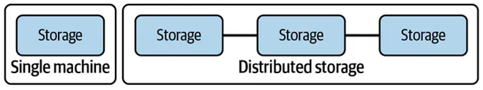
Single Machine vs Distributed Storage
As data storage and access patterns become more complex and outgrow the usefulness of a single server distributing data to more than one server becomes necessary
Data can be stored on multiple servers, known as distributed storage, with purpose is to store data in a distributed fashion
Distributed storage coordinates the activities of multiple servers
To store, retrieve, and process data faster and at a larger scale, all while providing redundancy in case a server becomes unavailable
Provides built-in redundancy and scalability for large amounts of data
Examples, object storage, Apache Spark, and cloud data warehouses rely on distributed storage architectures

Slide 27
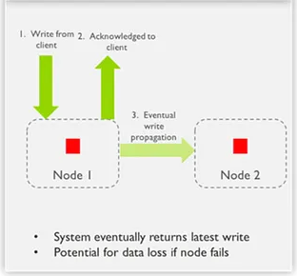
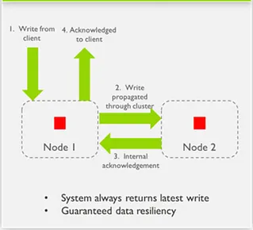
Eventual vs Strong Consistency
A challenge with distributed systems is that your data is spread across multiple servers.
Unfortunately, distributed systems pose a dilemma for storage and query accuracy.
It takes time to replicate changes across the nodes of a system; often a balance exists between getting current data and getting “sorta” current data in a distributed database.
Eventual consistency is a common trade-off in large-scale, distributed systems.
Eventual consistency allows you to retrieve data quickly without verifying that you have the latest version across all nodes
With strong consistency, the distributed database ensures that writes to any node are first distributed with a consensus and that any reads against the database return consistent values.
Eventual Consistency
Image Source
Strong Consistency

Slide 28
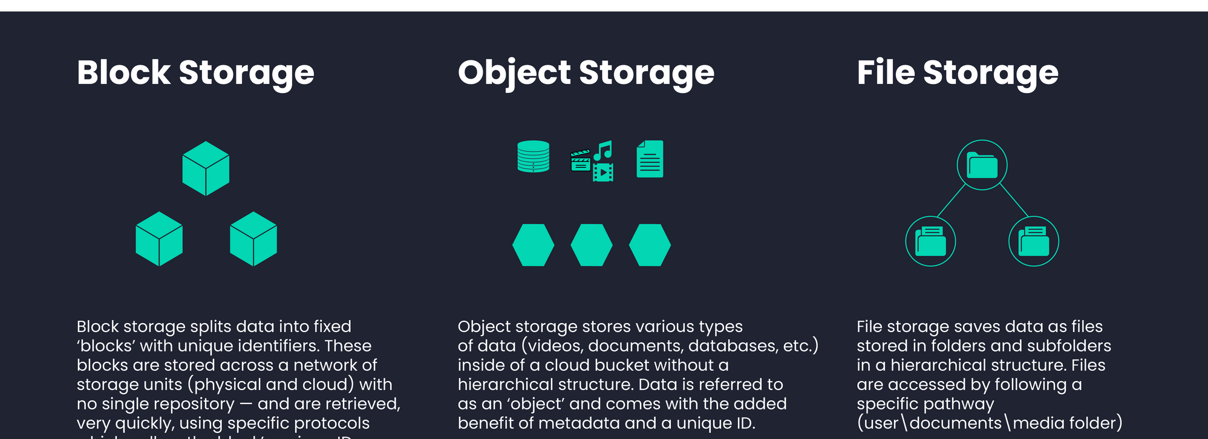
Storage Types
Image Source

Slide 29
File Storage
A file is a data entity with specific read, write, and reference characteristics used by software and operating systems
Characteristics of a File
Has finite length - stream of bytes
Supports append operations - append bytes to the files
Supports random access - read from any location in the file or write updates to any location
Organization
File storage systems organize files into a directory tree
Eg: /Users/Sunil/file.txt
File System
The filesystem stores each directory as metadata about the files and directories that it contains
Consists of the name of each entity, relevant permission details, and a pointer to the actual entity/file
To find a file on disk, the operating system looks at the metadata at each hierarchy level and follows the pointer to the next subdirectory entity until finally reaching the file itself.

Slide 30
File Storage - Types
Local disk storage
The most familiar type of file storage is an operating system–managed filesystem on a local disk partition of SSD or magnetic dis
New Technology File System (NTFS) and ext4 are popular filesystems on Windows and Linux respectively
OS handles the details of storing directory entities, files, and metadata
Designed to write data to allow for easy recovery in the event of power loss during a write, though any unwritten data will still be lost.
Support full read after write consistency; reading immediately after a write will return the written data
Employs various locking strategies to manage concurrent writing attempts to a file

Slide 31
File Storage – Types - Contd
Network-attached storage
Provide a file storage system to clients over a network
Prevalent solution for servers; they quite often ship with built-in dedicated NAS interface hardware
Has performance penalties to accessing the filesystem over a network
Significant advantages includes redundancy and reliability, fine-grained control of resources and file sharing across multiple machines
Cloud filesystem services
Provide a fully managed filesystem for use with multiple cloud VMs and applications, potentially including clients outside the cloud environment
Should not be confused with standard storage attached to VMs—generally, block storage with a filesystem managed by the VM operating system
Behave much like NAS solutions, but the details of networking, managing disk clusters, failures, and configuration are fully handled by the cloud vendor
Amazon Elastic File System (EFS) is an extremely popular example of a cloud filesystem service

Slide 32
Block Storage
Fundamentally type of raw storage provided by SSDs and magnetic disks
In the cloud, virtualized block storage is the standard for VMs
Allow fine control of storage size, scalability, and data durability beyond that offered by raw disks.
Block storage applications
Transactional database systems generally access disks at a block level to lay out data for optimal performance
Operating system boot disks on cloud VMs
Characteristics of a block
A block is the smallest addressable unit of data supported by a disk
Often 512 bytes of usable data on older disks, but it has now grown to 4,096 bytes for most current disks
Also contain extra bits for error detection/correction and other metadata
Blocks on magnetic disks are geometrically arranged on a physical platter
Two blocks on the same track can be read without moving the head, while reading two blocks on separate tracks requires a seek
Seek time can occur between blocks on an SSD, but this is infinitesimal compared to the seek time for magnetic disk tracks.

Slide 33
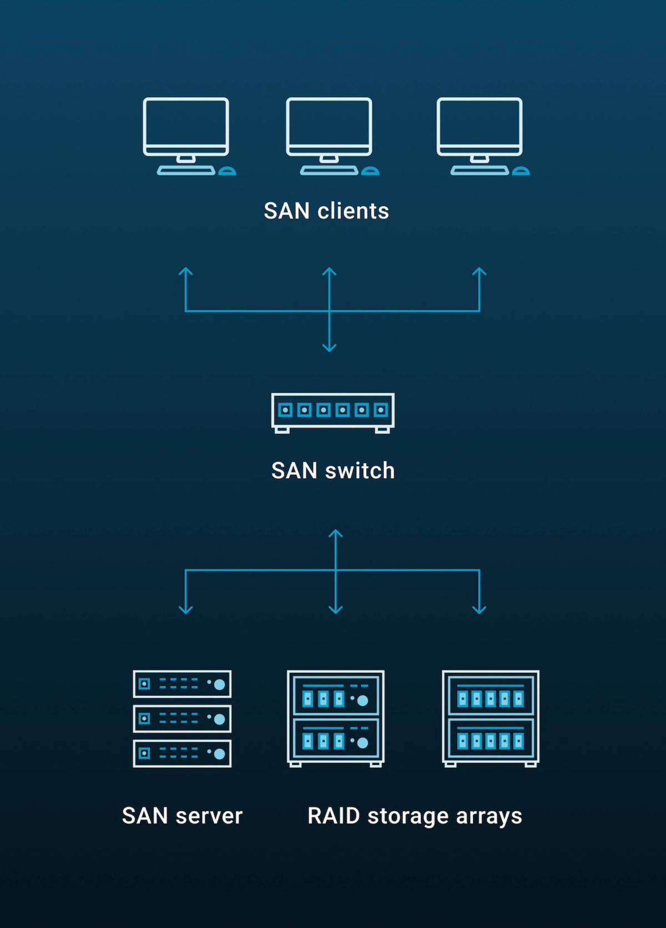
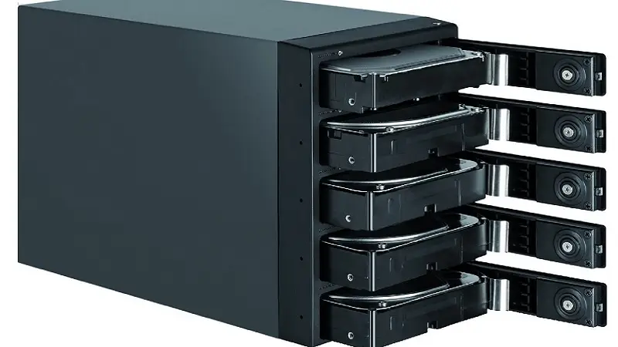
Block Storage - Types
RAID
Redundant Array of Independent Disks
simultaneously controls multiple disks to
improve data durability
enhance performance
combine capacity from multiple drives
An array can appear to the operating system as a single block device
SAN
Storage area network
Provide virtualized block storage devices over a network, typically from a storage pool
Allow fine-grained storage scaling and enhance performance, availability, and durability
Common with on-premises storage systems
Image Source
Image Source

Slide 34
Block Storage – Types - Contd
Cloud Virtualized Block Storage
Similar to SAN but free engineers from dealing with SAN clusters and networking details
Example, Amazon Elastic Block Store (EBS) - default storage for Amazon EC2 virtual machines
Store data separate from the instance host server but in the same zone to support high performance and low latency
Allows EBS volumes to persist when an EC2 instance shuts down, when a host server fails, or even when the instance is deleted
Suitable for applications such as databases, where data durability is a high priority
Replicates all data to at least two separate host machines, protecting data if a disk fails
Local Instance Volumes
Cloud providers also offer block storage volumes that are physically attached to the host server running a virtual machine
Generally very low cost (included with the price of the VM in the case of Amazon’s EC2 instance store) and provide low latency
When a VM shuts down or is deleted, the contents of the locally attached disk are lost, whether or not this event was caused by intentional user action
Ensures that a new virtual machine cannot read disk contents belonging to a different customer

Slide 35
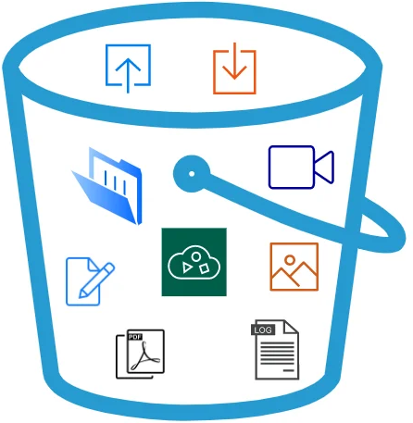
Object Storage
Contains objects of all shapes and sizes - a specialized file-like construct —TXT, CSV, JSON, images, videos, or audio
Have grown in importance and popularity with the rise of big data and the cloud
Amazon S3, Azure Blob Storage, and Google Cloud Storage (GCS) are widely used
Many cloud data warehouses (and a growing number of databases) utilize object storage as their storage layer
Cloud data lakes generally sit on object stores
Serverless
Object storage was arguably one of the first “serverless” services
Engineers don’t need to consider the characteristics of underlying server clusters or disks

Slide 36
Object Storage
An object store is a key-value store for immutable data objects.
Don’t support random writes or append operations; instead, they are written once as a stream of bytes
After this initial write, objects become immutable
To change data in an object or append data to it, must rewrite the full object
Support random reads through range requests

Slide 37
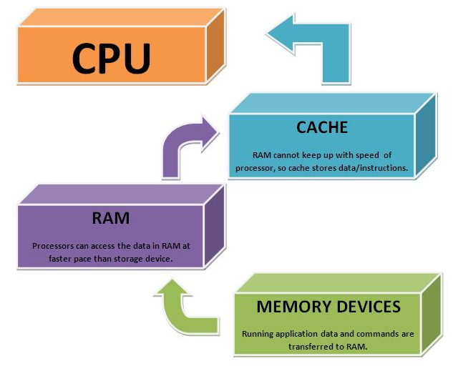
Cache and Memory-Based Storage Systems - Contd
RAM offers excellent latency and transfer speeds but extremely vulnerable to data loss
RAM-based storage systems are generally focused on caching applications, presenting data for quick access and high bandwidth
Data should generally be written to a more durable medium for retention purposes
These ultra-fast cache systems are useful when data engineers need to serve data with ultra-fast retrieval latency
RAM-based storage systems
Image Source

Slide 38
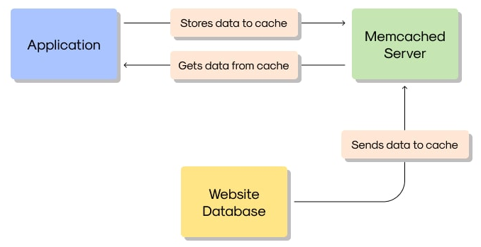
Cache and Memory-Based Storage Systems - Contd
A key-value store designed for caching database query results, API call responses, and more
Uses simple data structures, supporting either string or integer types
Deliver results with very low latency while also taking the load off backend systems
Memcached and lightweight object caching
Image Source

Slide 39
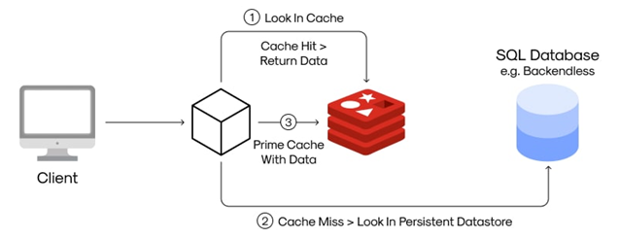
Cache and Memory-Based Storage Systems - Contd
Memory caching with optional persistence
A key-value store, but it supports somewhat more complex data types (such as lists or sets)
With a typical configuration, Redis writes data roughly every two seconds
Redis is thus suitable for extremely high-performance applications but can tolerate a small amount of data loss
Redis Cache
Image Source

Slide 40
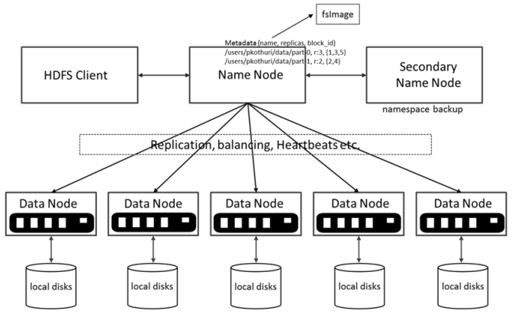
Hadoop Distributed File System
Image Source

Slide 41
Hadoop Distributed File System - Contd
Based on Google File System (GFS) and was initially engineered to process data with the MapReduce programming model
Similar to object storage but with a key difference: Hadoop combines compute and storage on the same nodes, where object stores typically have limited support for internal processing
Management
Breaks large files into blocks, chunks of data less than a few hundred megabytes in size
Managed by the NameNode, which maintains directories, file metadata, and a detailed catalog describing the location of file blocks in the cluster
Each block of data is replicated to three nodes - increases both the durability and availability of data

Slide 42
Hadoop Distributed File System - Contd
Claims that Hadoop is dead! This is only partially true!
No longer a hot, bleeding-edge technology
Many Hadoop ecosystem tools such as Apache Pig are now on life support and primarily used to run legacy jobs
The pure MapReduce programming model has fallen by the wayside
But HDFS remains widely used in various applications and organizations
HDFS is a key ingredient of many current big data engines, such as Amazon EMR
In fact, Apache Spark is still commonly run on HDFS clusters

Slide 43
Streaming Data Storage
Sender
Stream
Receiver
Streaming DB
Streaming data has different storage requirements than non-streaming data - retention, replay!
Retention
In the case of message queues, stored data is temporal and expected to disappear after a certain duration
Distributed, scalable streaming frameworks like Apache Kafka now allow extremely long-duration streaming data retention
Kafka competitors (including Amazon Kinesis, Apache Pulsar, and Google Cloud Pub/Sub) also support long data retention
Replay
Allows a streaming system to return a range of historical stored data
Standard data-retrieval mechanism for streaming storage systems
Can be used to run batch queries over a time range or to reprocess data in a streaming pipeline

Slide 44
Data Storage Infrastructure -Storage Abstractions

Slide 45
Abstractions
Data engineering storage abstractions are data organization and query patterns that sit at the heart of the data engineering lifecycle
Are built atop the data storage systems
The main types of abstractions are those that support data science, analytics, and reporting use cases
Data warehouse
Data lake
Data lakehouse
Data platforms
Data catalogs

Slide 46
Data Serving Infrastructure

Slide 47
Introduction
Reverse ETL
Generation/Source
Ingestion
Data Analytics
Storage
Transformation
Serving
Data Science & Machine Learning

Slide 48
Data Serving Infrastructure - Reverse ETL

Slide 49
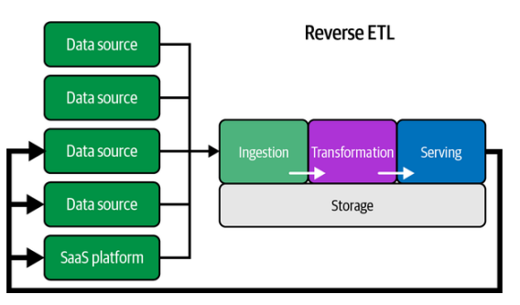
What is it?
How many times, you feel that the latest business parameters and threshold if available as input will be helpful?
Process of sending data back to data sources
For example, might acquire data from an adtech platform, run a statistical process on this data to determine cost-per-click bids, and then feed this data back into the ad tech platform
Can you give an example?

Slide 50
Example
For example,
A data engineer might pull customers and order data from a CRM and store it in a data warehouse
This data is used to train a lead scoring model, whose results are returned to the data warehouse
Company’s sales team wants access to these scored leads to try to generate more sales
Have a few options to get the results of this lead scoring model into the hands of the sales team
Can put the results in a dashboard for them to view
Or might email the results to them as an Excel file

Slide 51
Detailed
The challenge with these approaches is that they are not connected to the CRM, where a salesperson does their work
Why not just put the scored leads back into the CRM?
Using reverse ETL and loading the scored leads back into the CRM is the easiest and best approach for this data product
Reverse ETL takes processed data from the output side of the data engineering lifecycle and feeds it back into source systems
Do you see any challenges?
A practical challenge in implementing this: Data transformation and validation from the output to the source system
Some tools used: Hightouch, Census, Fivetran, Airbyte, and RudderStack

Slide 52
Data Serving Infrastructure - Data Analytics

Slide 53
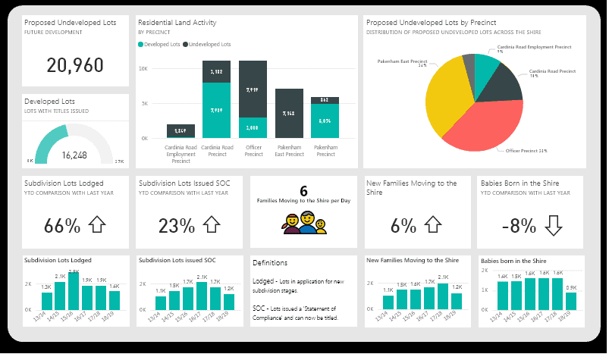
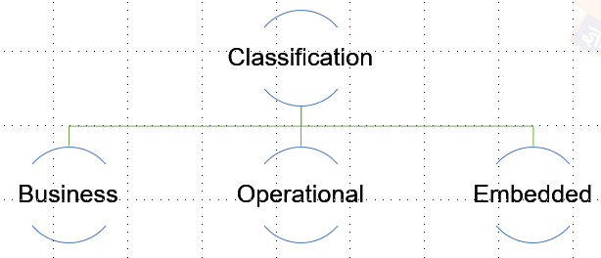
Introduction
Discovering, exploring, identifying, and making visible key insights and patterns within data
Carried out using statistical methods, reporting, BI tools, and more
Most traditional area of data serving
Prepare data for use in statistical analysis, reporting, and dashboards
Important as ever for stakeholders to have visibility into the business, organizational, and financial processes
SAMPLE

Slide 54
Detailed
Business Analytics
uses historical and current data to make strategic and actionable decisions
types of decisions tend to factor in longer-term trends and often involve a mix of statistical and trend analysis, alongside domain expertise and human judgment
typically falls into a few big areas—dashboards, reports, and ad hoc analysis
Operational Analytics
uses data to take immediate action:
Operational analytics versus business analytics = immediate action versus actionable insights
big difference between operational and business analytics is time
as real-time updates can be impactful in addressing a problem when it occurs
The line between business and operational analytics has begun to blur!
Sample tools: Tableu, PowerBI, Qlik

Slide 55
Detailed
Embedded Analytics
Whereas business and operational analytics are internally focused, a recent trend is external-facing or embedded analytics
With so much data powering applications, companies increasingly provide analytics to end users
Typically referred to as data applications, often with analytics dashboards embedded within the application itself
The landscape of embedded analytics is snowballing, and expect that such data applications will become increasingly pervasive within the next few years.
Sample tools: Looker, Qlik Embedded, Sisense

Slide 56
Data Serving Infrastructure - Data Science & Machine Learning

Slide 57
Introduction
All data science and machine learning projects have a few key elements in common:
In the technical point of view, all projects involve data and computation at their foundation.
All projects will eventually need to address the question of integrating results into production systems which typically involves a great deal of software engineering.
Finally, in the human point of view, all projects involve experimentation and iteration, which many consider to be the central activity of data science.
Certainly possible for individuals companies or teams to come up with their own bespoke processes and practices to conduct data science projects,
A common infrastructure can help to increase the number of projects that can be
executed simultaneously (volume),
speed up the time-to-market (velocity),
ensure that the results are robust (validity), and
make it possible to support a larger variety of projects.

Slide 58
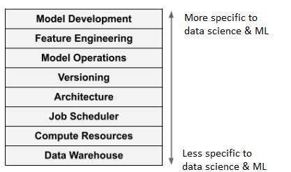
The Stack
Because of culture of open source and relatively free technical information sharing between companies,
Been able to observe and collect common patterns in data science & ML projects and infrastructure components
Implementation details vary, the major infrastructural layers are relatively uniform across a large number of projects
Each layer can be implemented in various ways, driven by the specific needs of their environment and use cases
But the big picture is remarkably consistent!
The most fundamental, generic components are at the bottom of the stack
The layers become more specific to data science & ML towards the top of the stack

Slide 59
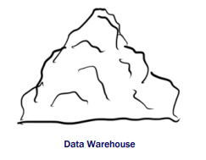
Datawarehouse
The bottom most layer and we discussed about this multiple times
Place where data is stored
Doesn’t do anything by itself but how data is stored is critical
A key challenge is to lay out the data in a way that makes it easily
Discoverable and efficiently accessible by data science applications while maintaining a high degree of durability (naturally the data warehouse must not lose data. )

Slide 60
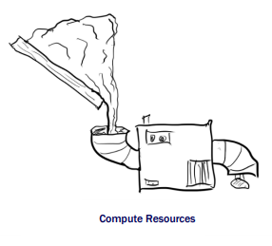
Compute Resources
Need to have a way to do something with data, in other words, take some data, apply an algorithm and get results
A challenge is that algorithms come in many shapes and sizes and need to run many of them, often in parallel, very frequently
Need a system that can provide computing resources on demand
The compute layer doesn’t dictate what is computed
Blindly accepts an algorithm from the outside world and executes it, consuming and producing data

Slide 61
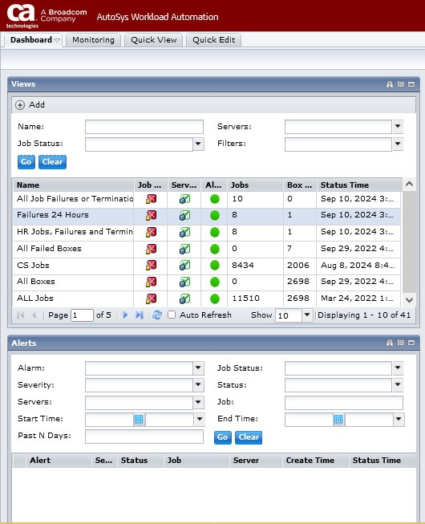
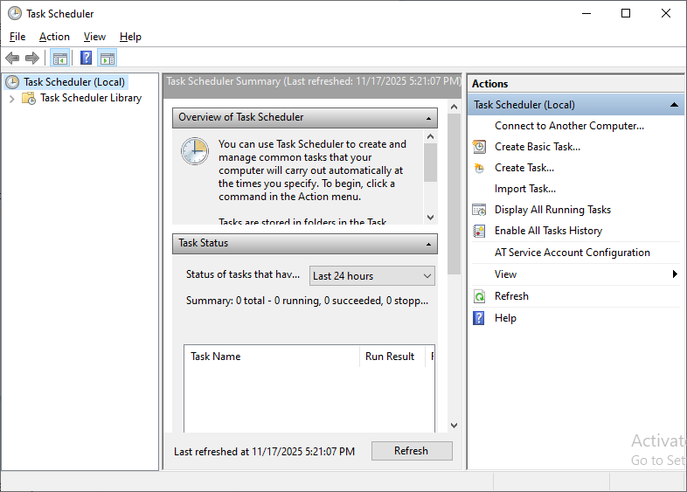
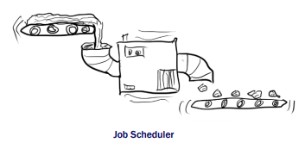
Job Scheduler
Have you seen these screens?
Image Source
Training a machine learning model or other data science application is rarely a one-time operation
More often it is a repeating process
Need to feed fresh data in the algorithm at a regular cadence
Job of the scheduling layer to keep all the data flowing and all the machines humming uninterruptedly
A key challenge is to keep the scheduling system itself up all the time and make sure it can manage almost any number of concurrent machines and data pipelines

Slide 62
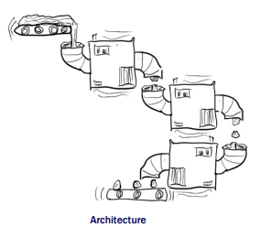
Architecture
Data warehouse, compute resources, and job scheduler, are generic in nature: can be used to execute any workloads
At the architecture layer defines what application is and how it is going to work
includes defining an algorithm or several algorithms and how the scheduling layer is supposed to connect the algorithms and the data pipelines together
A key challenge is that of software engineering in general
How to map a real-world problem into an effective and robust software architecture.

Slide 63
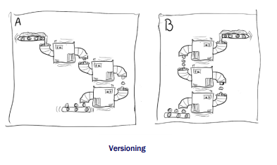
Versioning
“Experimentation and Iteration” as one of the common themes in data science projects
A concrete ramification of this is that architectures we define are always subject to change, makes sense to organize the work accordingly
To complicate matters further, in the case of data science and/or ML the question of which version of the application is better is often non-trivial
To judge the versions properly, you may need to run multiple versions side by side.
A key challenge is that can evaluate results reliably only if the applications are well isolated, that is, they must not interfere with each other
Must isolate the algorithms themselves, the input and output data, and the scheduled pipelines

Slide 64
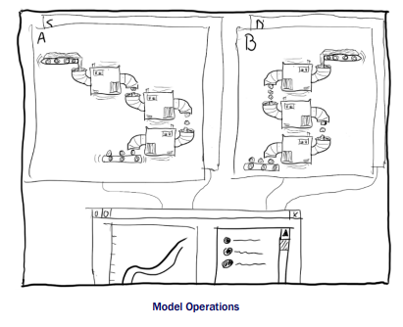
Model Operations
Imagine four versions of an application running, each with their own version of code and data
Each version may be built by a separate data scientist, all of whom are all iterating on their versions independently.
The result, unless organized properly, can be a logistical nightmare!
Role of the model operations layer to help
To deploy, monitor, and assure validity of all models at all times, without hindering the speed of experimentation
To make this possible, the infrastructure needs to track metadata about all executions and models, from prototype to production

Slide 65
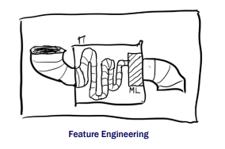
Feature Engineering
Typically, the raw input data is not fed directly into the model but it goes through a sequence of data transformations
Designing this sequence is a major part of the data scientist’s work when they are developing a new model or trying to improve performance of an existing model
A key challenge is to make this process as efficient as possible

Slide 66
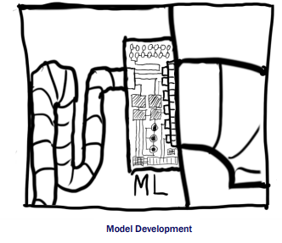
Model Development
At the very top of the stack there’s the layer of model development
Finding and describing a mathematical model that transforms features into desired outputs
A key challenge, and the key expertise of a data scientist, is to understand what modeling approach is most appropriate for the task at hand and how to implement it typically using off-the-shelf libraries.
Occupies only a tiny part of the end-to-end machinery that makes an effective data science and/or ML application
Shouldn’t underestimate the effort that it takes to embed intelligence in the surrounding environment, which is what this stack is all about!

Slide 67
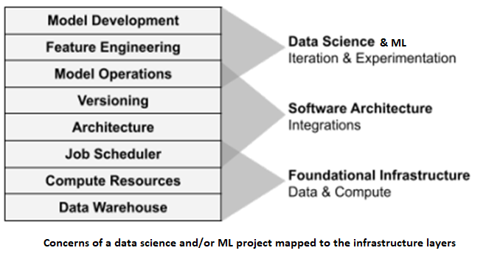
Stack Again
Every data science project regardless of the problem domain needs to deal with data and compute
So these layers form the foundational infrastructure
Layers are agnostic of what exactly gets executed
The middle layers
Define the software architecture of an individual data science or ML application
What gets executed and how: the algorithms, data pipelines, deployment strategies, and how results should be distribute
Much about the work is about integrating existing software components together.
The top of the stack
Realm of data science and or ML:
Defining a mathematical model and how to transform raw input to something that the model can process
Can evolve quickly as the data scientist experiments with different approaches

Slide 68
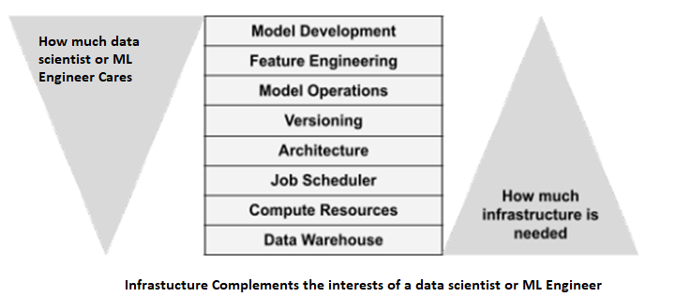
Data Scientists/ ML Engineers Freedom and Responsibility

Slide 69
Data Serving Infrastructure - Ways to serve data

Slide 70
Introduction
Ways
File Exchange
Databases
Streaming Systems
Query Federation
Jupyter Notebook

Slide 71
File Exchange
Is ubiquitous in data serving. We process data and generate files to pass to data consumers
A data scientist might load a text file (unstructured data) of customer messages to analyze the sentiments of customer complaints
A business unit might receive invoice data from a partner company as a collection of CSVs (structured data)
An analyst must perform some statistical analysis on these files
The way files are served depends on several factors, such as these:
Use case — business analytics, operational analytics, embedded analytics
The data consumer’s data-handling processes
The size and number of individual files in storage
Who is accessing this file
Data type — structured, semi-structured, or unstructured

Slide 72
Databases
Critical layer in serving data for analytics and ML - serving data from OLAP databases (e.g.,data
warehouses and data lakes)
Serving data involves querying a database and then consuming those results for a use case
An analyst or data scientist might query a database by using a SQL editor and export those results to a CSV file for consumption by a downstream application, or analyze the results in a notebook
Carries a variety of benefits
A database imposes order and structure on the data through schema
Databases can offer fine-grained permission controls at the table, column, and row level, allowing database administrators to craft complex access policies for various roles
Databases can offer high serving performance for large, computationally intensive queries and high query concurrency
A data scientist might connect to a database, extract data, and perform feature engineering and
selection
Converted dataset is then fed into an ML model
offline model is trained and produces predictive results
Data engineers are quite often tasked with managing the database-serving layer.

Slide 73
Streaming Systems
Increasingly important in the realm of serving
Type of serving may involve emitted metrics, which are different from traditional queries
Operational analytics databases playing a growing role in this area
Allow queries to run across a large range of historical data, encompassing up-to-the-second current data
Combine aspects of OLAP databases with stream-processing systems
Increasingly work with streaming systems to serve data for analytics and ML, so get familiar with this paradigm

Slide 74
Query Federation
Query federation pulls data from multiple sources, such as data lakes, RDBMSs, and data
warehouses
Becoming more popular as distributed query virtualization engines gain recognition as ways to serve queries
Without going through the trouble of centralizing data in an OLAP system
Trino and Presto and managed services such as Starburst
End user might be querying several systems—OLTP, OLAP, APIs, filesystems, etc.
Instead of serving data from a single system, now serving data from multiple systems, each with its usage patterns, quirks, and nuances
If federated queries touch live production source systems, need to ensure that the federated query won’t consume excessive resources in the source
Federation allows ad hoc queries for performing exploratory analysis, blending data from various
systems without the complexity of setting up data pipelines or ETL
Federated queries also provide read-only access to source systems, which is great when you don’t want to serve files, database access, or data dump
The end user reads only the version of the data they’re supposed to access and nothing more
Query federation is a great option to explore for situations where access and compliance are critical

Slide 75
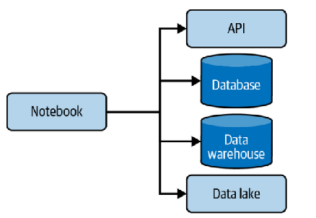
Jupyter Notebook
Data scientists often use notebooks in their day-to-day work for exploring data, engineering features, or training a model
Jupyter Notebook, along with its next-generation iteration,
JupyterLab
open source and can be hosted locally on a laptop, on a server, or through various cloud-managed services
Jupyter stands for Julia, Python, and R
Data scientists will programmatically connect to a data
source, such as an API, a database, a data warehouse, or a data lake
In a notebook, all connections are created using
the appropriate built-in or imported libraries to load a file from a filepath
connect to an API endpoint
or make an ODBC connection to a database

Slide 76
Automation in Data Infrastructure Management

Slide 77
Summary of Data Infrastructure Components
Storage systems (data lakes, warehouses, lakehouses)
Databases (RDBMS, NoSQL, time-series)
Compute (ETL/ELT engines, clusters, serverless)
Orchestration engines
Integration components (APIs, messaging)

Slide 78
Key Areas for Automation
Infrastructure Provisioning
Provisioning of infrastructure through automation scripts
Have you ever requested for virtual machines? How quickly you normally get them?
If you say quite fast, how is it achieved?
Tools
IaC(Infrastructure as Code): Terraform, Pulumi, AWS CDK, Azure Bicep
GitOps: ArgoCD, Flux
Cloud-native deployment templates – Cloud formation(You will see how your lab environment gets setup quickly in your webinar)

Slide 79
Key Areas for Automation
Pipeline Automation
Key for data pipelines
Includes ETL/ELT workflows, streaming jobs, trigger based transfers, scheduled data pipeline execution
Automatically rerun failed tasks with backoff strategy
Schema-change detection triggers auto-update of downstream models (e.g., dbt tests + deployments)
Tools
Orchestrators: Airflow, Dagster, Prefect
Event-driven pipelines: EventBridge, Azure Event Grid, Kafka Streams
Self-healing workflows (retry, fallback, alternative route)

Slide 80
DevOps & DataOps Foundation

Slide 81
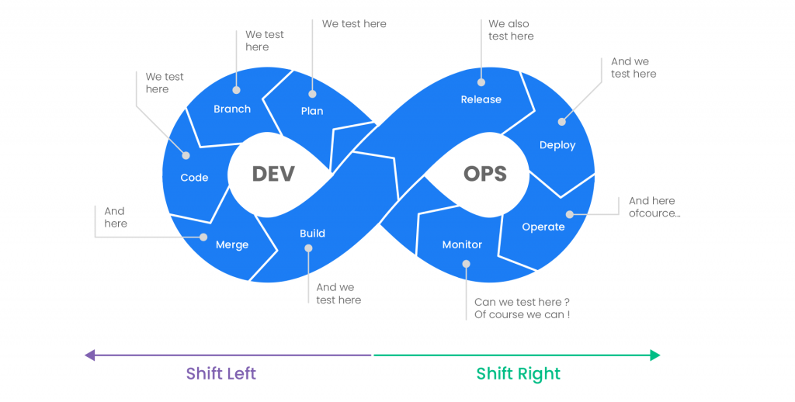
Devops
Here we work on code

Slide 82
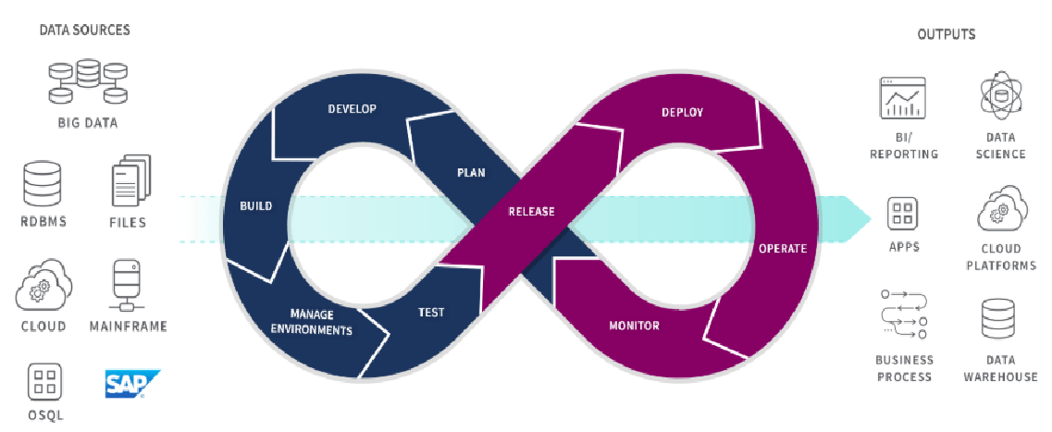
Devops for data
Image Source
Here we work on
data pipeline development – which is dev
Monitoring, troubleshooting, enhancing – which is ops
DataOps employs agile processes for data governance and analytics development and DevOps processes for code optimization, product builds, and delivery. In addition to building new code, streamlining and improving the data warehouse are crucial.

Slide 83
Cloud Foundation

Slide 84
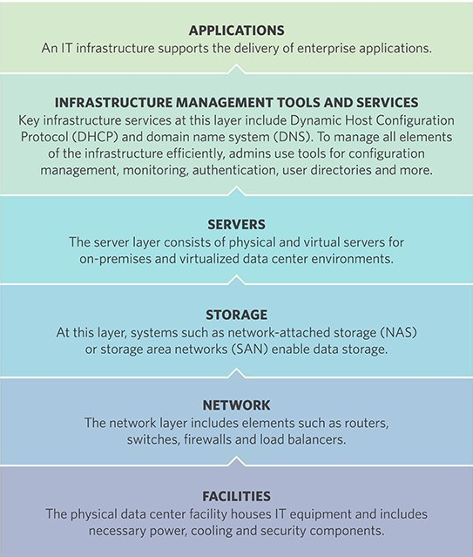
Typical On-Prem Infrastructure Components
Source

Slide 85
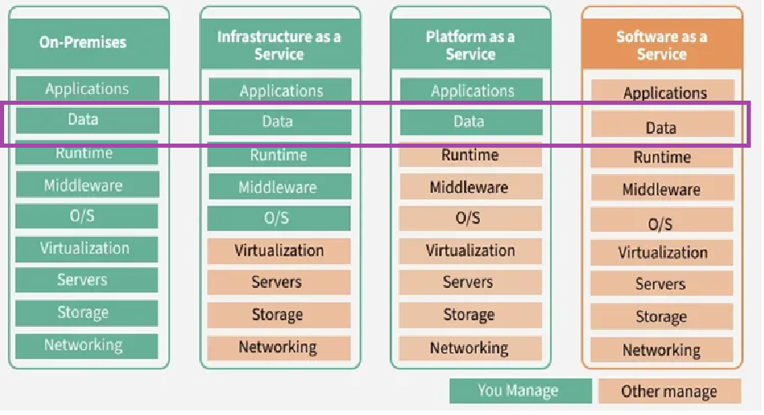
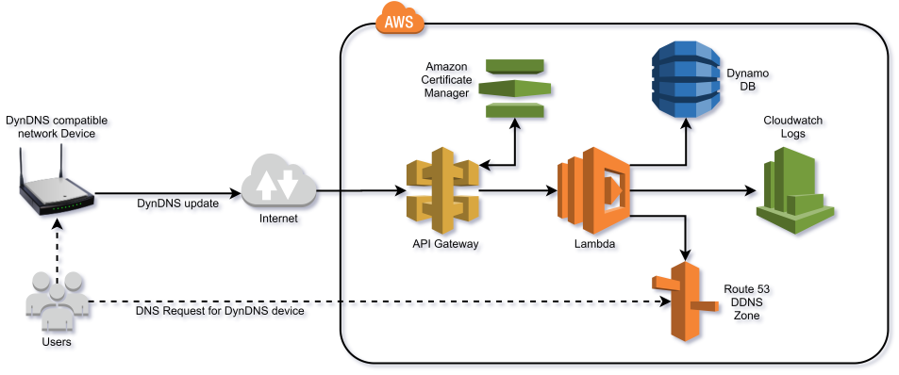
Cloud Infra
The delivery of computing services—including storage, databases, software, and servers—over the internet on a pay-as-you-go basis
Databases and its related services like, pipeline builders, streaming platforms, API gateways, data stores are readily available as a service

Slide 86
Security Foundation

Slide 87
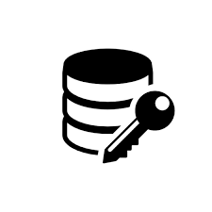


Data Security - Basics
What should we worry about?
Data At Rest
Data At Transit
Data In Use
Data that is stored in a medium
Encryption of entire medium
Data that is actively moving from one system/application to another system/application
Message Encryption
Data that is being used by someone
Role Based Access Control

Slide 88
Continuous Training (CT) and Continuous Deployment (CD) pipelines

Slide 89
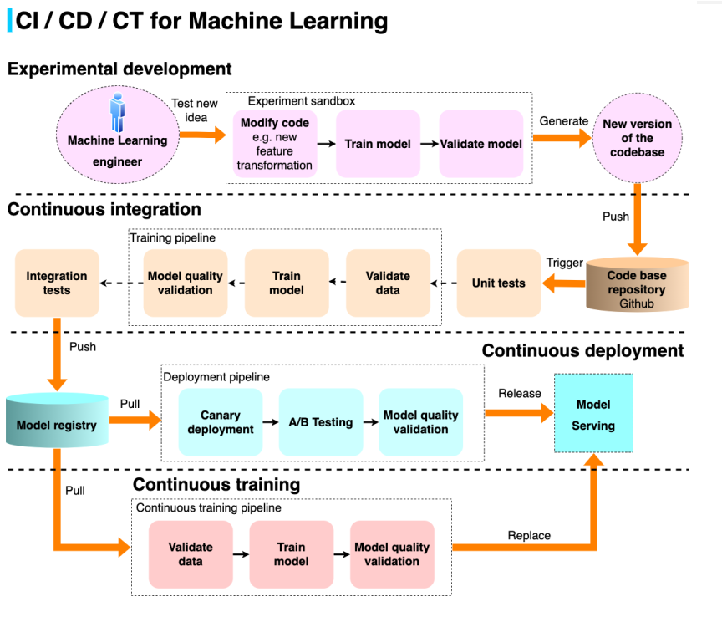
Introduction
Image Source

Slide 90
Key Phases
The experimental phase - The ML Engineer wants to test a new idea (let's say a new feature transformation). He modifies the code base to implement the new transformation, trains a model, and validates that the new transformation indeed yields higher performance. The resulting outcome at this point is just a piece of code that needs to be included in the master repo.
Continuous integration - The engineer then creates a Pull request (PR) that automatically triggers unit testing (like a typical CI process) but also triggers the instantiation of the automated training pipeline to retrain the model, potentially test it through integration tests or test cases and push it to a model registry. There is a manual process for another engineer to validate the PR and performance reading of the new model.
Continuous deployment - Activating a deployment triggers a canary deployment to make sure the model fits in a serving pipeline and runs an A/B test experiment to test it against the production model. After satisfactory results, we can propose the new model as a replacement for the production one.
Continuous training - as soon as the model enters the model registry, it deteriorates, and you might want to activate recurring training right away. For example, each day, the model can be further fine-tuned with the new training data of the day, deployed, and the serving pipeline rerouted to the updated model.

Slide 91
DataOps and Observability

Slide 92
Key Phases
Observability is no longer just for software engineering!
With the rise of data downtime and the increasing complexity of the data stack,
observability has emerged as a critical concern for data teams, too.
Developer Operations (DevOps) teams have become an integral component of most engineering organizations
remove silos between software developers and IT, facilitating the seamless and reliable release of software to production
As organizations grow and the underlying tech stacks powering them become more complicated
it’s important for DevOps teams to maintain a constant pulse on the health of their systems
Observability, a more recent addition to the engineering lexicon, speaks to this need, and refers to the monitoring, tracking, and triaging of incidents to prevent downtime.
A dedicated session on observability will be coming in future

Slide 93
Case Study

Slide 94
Background & Problem Statement
DoorDash is an American technology company that operates an on-demand delivery platform connecting consumers with local merchants for food, groceries, and other retail items. It is the largest food delivery service in the United States and facilitates deliveries through independent contractors called "Dashers".
Business Problem
Their earlier ML workflows were:
Fragmented (analytics, batch ML, real-time ML all separate)
Low observability (data issues → incorrect ETAs)
Slow deployment (weeks)
Frequent data drift
Manual pipeline debugging
DoorDash needed a unified, reliable, production-grade ML data platform.

Slide 95
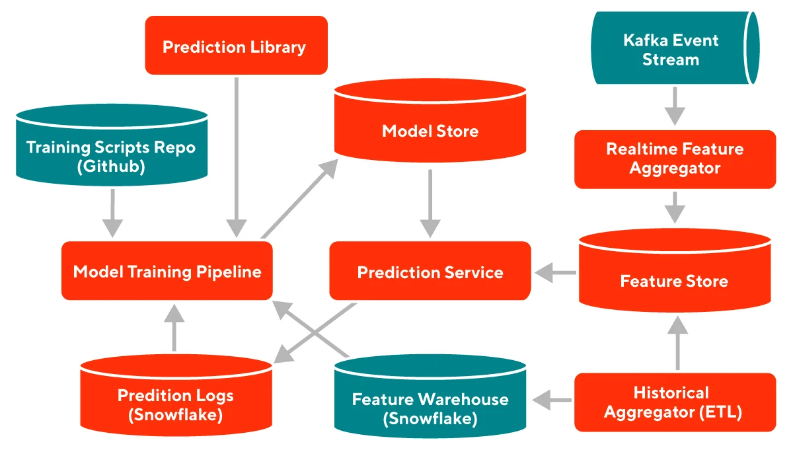
Architecture of the DoorDash ML Platform
Image Source

Slide 96
Components
Feature Store - Low latency store from which Prediction Service reads common features needed for evaluating the model. Supports numerical, categorical, and embedding features.
Realtime Feature Aggregator - Listens to a stream of events and aggregates them into features in realtime and stores them in the Feature Store. These are for features such as historic store wait time in the past 30 mins, recent driving speeds, etc.
Historical Aggregator - This runs offline to compute features which are longer-term aggregations like 1W, 3M, etc. These calculations run offline. Results are stored in the Feature Warehouse and also uploaded to the Feature Store.
Prediction Logs - This stores the predictions made from the prediction service including the features used when the prediction was made and the id of the model used to make the prediction. This is useful for debugging as well as for training data for the next model refresh.
Model Training Pipeline - All the production models will be built with this pipeline. The training script must be in the repository. Only this training pipeline will have access to write models into the Model Store to generate a trace of changes going into the Model Store for security and audit. The training pipeline will eventually support auto-retraining of models periodically and auto-deploy/monitoring. This is equivalent to the CI/CD system for ML Models.
Model Store - Stores the model files and metadata. Metadata identifies which model is currently active for certain predictions, defines which models are getting shadow traffic.
Prediction Service - Serves predictions in production for various use cases. Given a request with request features, context (store id, consumer id, etc) and prediction name (optionally including override model id to support A/B testing), generates the prediction.

Slide 97
References:
Data Pipelines Pocket Reference By James Densmore
Fundamentals of Data Engineering By Joe Reis and Matt Housley
Effective Data Science Infrastructure By Ville Tuulos
Summary from https://medium.com/@ZhouAnnaWrites/book-notes-fundamentals-of-data-engineering-chapter-6-storage-81a533f81f0c
https://www.linkedin.com/pulse/continuous-integration-deployment-training-ci-cd-ct-damien-ajx7c/
https://www.techtarget.com/searchdatacenter/definition/infrastructure
https://www.pcloudy.com/cicd-pipeline-demystifying-the-complexities/
https://www.hardtechnology.net/post/dynamic-dns/
https://medium.com/innovationendeavors/operational-machine-learning-for-the-modern-data-stack-178a3feba334

Slide 98
Thank You!

